Slide 1
OPER 618 Lesson 01 Expected Utility Theory and Related Axioms
Dr. Brian J. Lunday
Office: Rm 201E, Bldg 641

Slide 2
Administration
Syllabus
Course outcomes
Assessments
Homework (8) 75% - no collaboration authorized
Research presentation 25% - no collaboration authorized
Course & AFIT Policies
Course Schedule
Office hours
Canvas LMS. https://a1-ims.okta.com/

Slide 3
Lesson Readings & Preparation
Syllabus/Canvas-assigned readings
Primary textbook readings
Support readings from the game theory primer
Supporting videos from the textbook authors
Technical article readings

Slide 4
Rational Choice Theory
Each agent exhibits optimal behavior
Decision-makers seek the best possible outcome for themselves.
Is this reasonable?
When/where does it hold?
When/where does it break down?
Under what conditions does it break down?

Slide 5
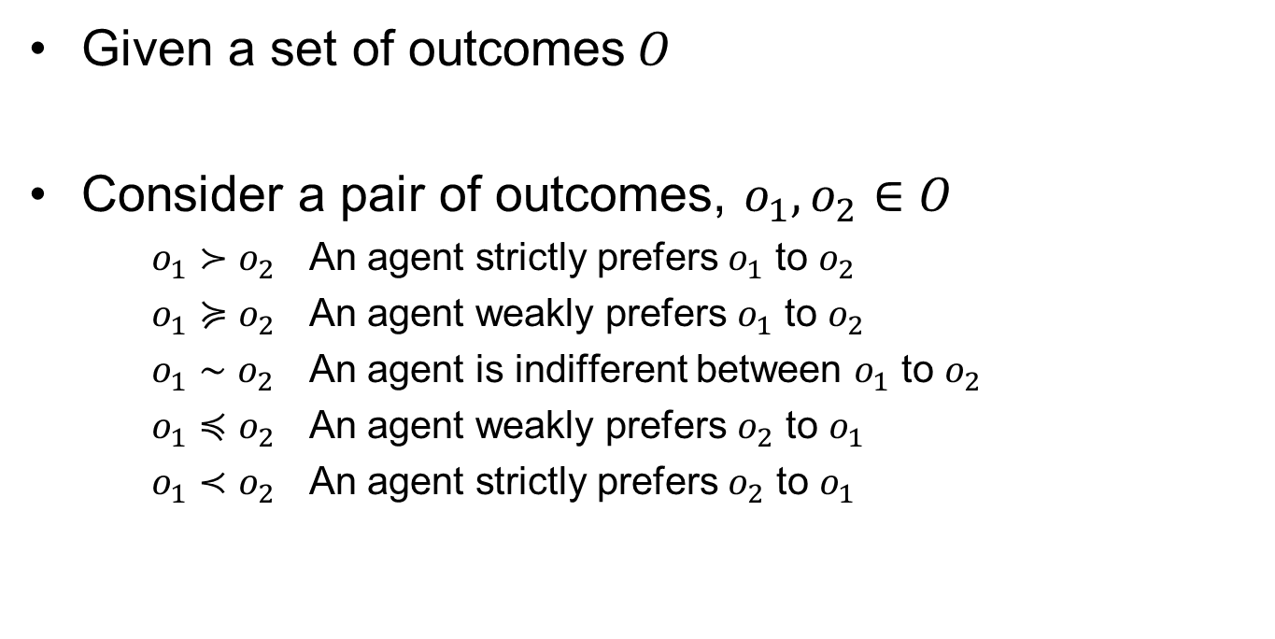
Preference Relations
Given a set of outcomes$O$
Consider a pair of outcomes, $o_{1},o_{2}∈O$
$o_{1}≻o_{2}$ An agent strictly prefers $o_{1}$ to $o_{2}$
$o_{1}≽o_{2}$ An agent weakly prefers $o_{1}$ to $o_{2}$
$o_{1}∼o_{2}$ An agent is indifferent between $o_{1}$ to $o_{2}$
$o_{1}≼o_{2}$ An agent weakly prefers $o_{2}$ to $o_{1}$
$o_{1}≺o_{2}$ An agent strictly prefers $o_{2}$ to $o_{1}$

Slide 6
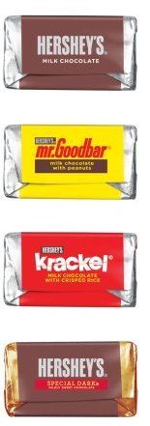
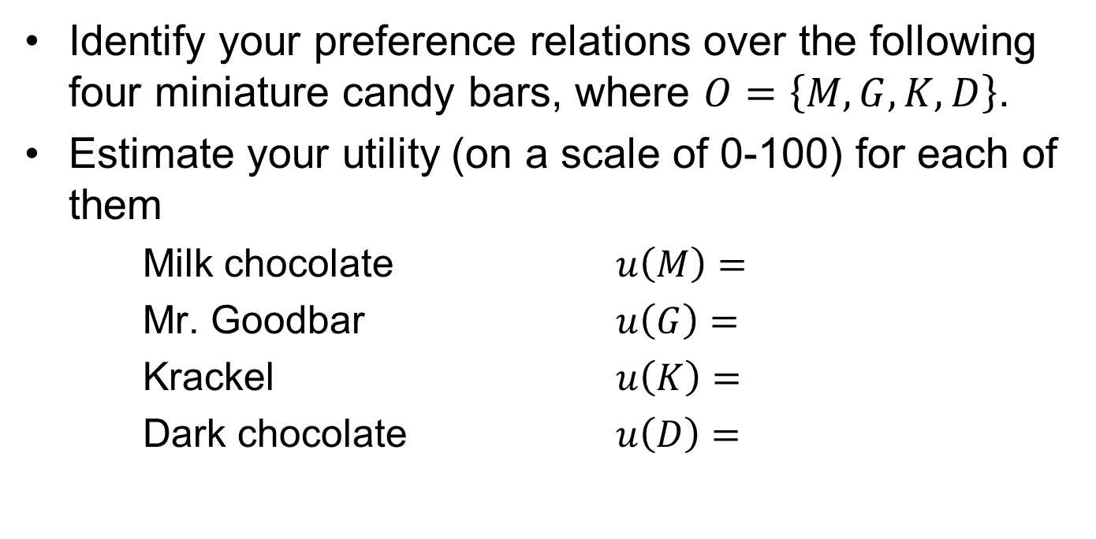
Quantifying Utility
Identify your preference relations over the following four miniature candy bars, where $O=\left\{M,G,K,D\right\}$.
Estimate your utility (on a scale of 0-100) for each of them
Milk chocolate $u\left(M\right)=$
Mr. Goodbar $u\left(G\right)=$
Krackel $u\left(K\right)=$
Dark chocolate $u\left(D\right)=$

Slide 7
Certainty, Risk, and Uncertainty
Outcomes may be categorized as having
Certainty. Given a set of players’ actions, an outcome is guaranteed.
Risk. Given a set of players’ action, one or more outcomes may be possible, each with a probability.
Uncertainty. Given an action, the outcome probabilities are unknown or meaningless.
What are some examples of each?
Where does game theory fit?

Slide 8


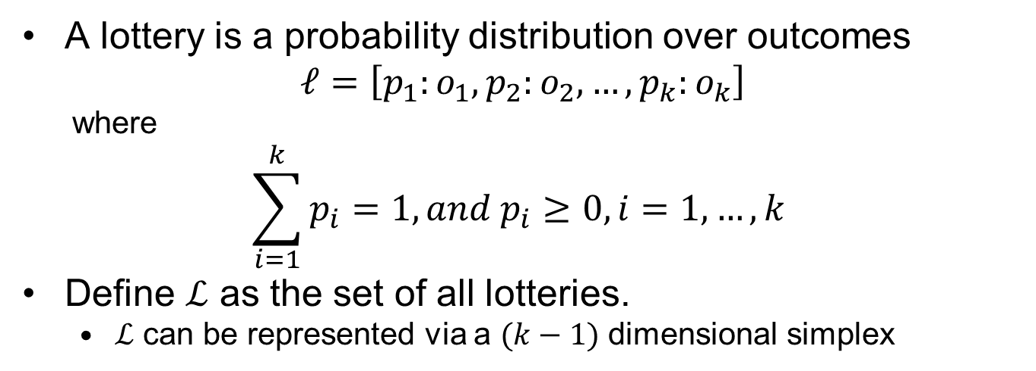



Simple Lotteries
A lottery is a probability distribution over outcomes
$$ℓ=\left[p_{1}:o_{1},p_{2}:o_{2},…,p_{k}:o_{k}\right]$$
where
$$\sum_{i=1}^{k}{p_{i}}=1, and p_{i}≥0, i=1,…,k$$
Define $ℒ$ as the set of all lotteries.
$ℒ$ can be represented via a $(k−1)$ dimensional simplex
$$\left(p_{1},p_{2},p_{3}\right)=\left(0,1,0\right)$$
$$\left(0,0.5,0.5\right)$$
$$\left(1/3,1/3,1/3\right)$$
$$\left(p_{1},p_{2},p_{3}\right)=\left(1,0,0\right)$$
$$\left(p_{1},p_{2},p_{3}\right)=\left(0,0,1\right)$$

Slide 9



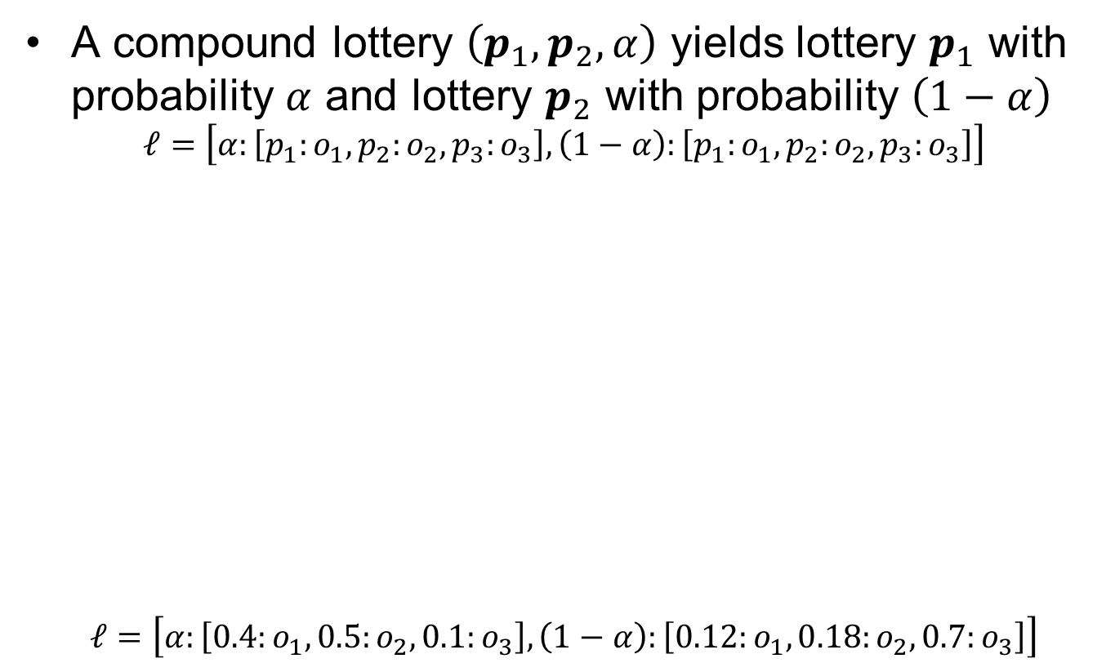




Compound Lotteries
A compound lottery $\left(p_{1},p_{2},α\right)$ yields lottery $p_{1}$ with probability $α$ and lottery $p_{2}$ with probability $\left(1−α\right)$
$$ℓ=\left[α:\left[p_{1}:o_{1},p_{2}:o_{2},p_{3}:o_{3}\right],\left(1−α\right):\left[p_{1}:o_{1},p_{2}:o_{2},p_{3}:o_{3}\right]\right]$$
$$ℓ=\left[α:\left[0.4:o_{1},0.5:o_{2},0.1:o_{3}\right],\left(1−α\right):\left[0.12:o_{1},0.18:o_{2},0.7:o_{3}\right]\right]$$
$$p_{1}$$
$$\left(p_{1},p_{2},p_{3}\right)=\left(0,1,0\right)$$
$$p_{2}$$
$$p_{1}$$
$$p_{2}$$
$$\left(p_{1},p_{2},p_{3}\right)=\left(1,0,0\right)$$
$$\left(p_{1},p_{2},p_{3}\right)=\left(0,0,1\right)$$

Slide 10
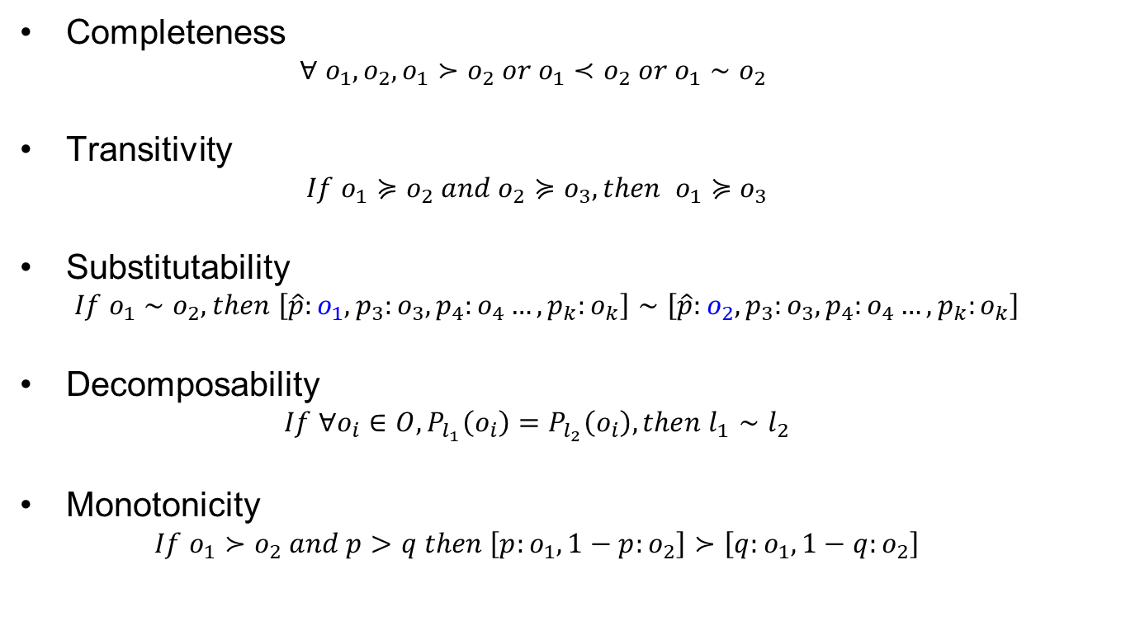
Axioms of Utility Theory (1 of 2)
Completeness
$$∀ o_{1},o_{2}, o_{1}≻o_{2} or o_{1}≺o_{2} or o_{1}∼o_{2}$$
Transitivity
$$If o_{1}≽o_{2} and o_{2}≽o_{3}, then o_{1}≽o_{3}$$
Substitutability
$$If o_{1}∼o_{2}, then \left[\hat{p}:o_{1},p_{3}:o_{3},p_{4}:o_{4}…,p_{k}:o_{k}\right]∼\left[\hat{p}:o_{2},p_{3}:o_{3},p_{4}:o_{4}…,p_{k}:o_{k}\right]$$
Decomposability
$$If ∀o_{i}∈O, P_{l_{1}}\left(o_{i}\right)=P_{l_{2}}\left(o_{i}\right),then l_{1}∼l_{2}$$
Monotonicity
$$If o_{1}≻o_{2} and p>q then \left[p:o_{1},1−p:o_{2}\right]≻\left[q:o_{1},1−q:o_{2}\right]$$

Slide 11
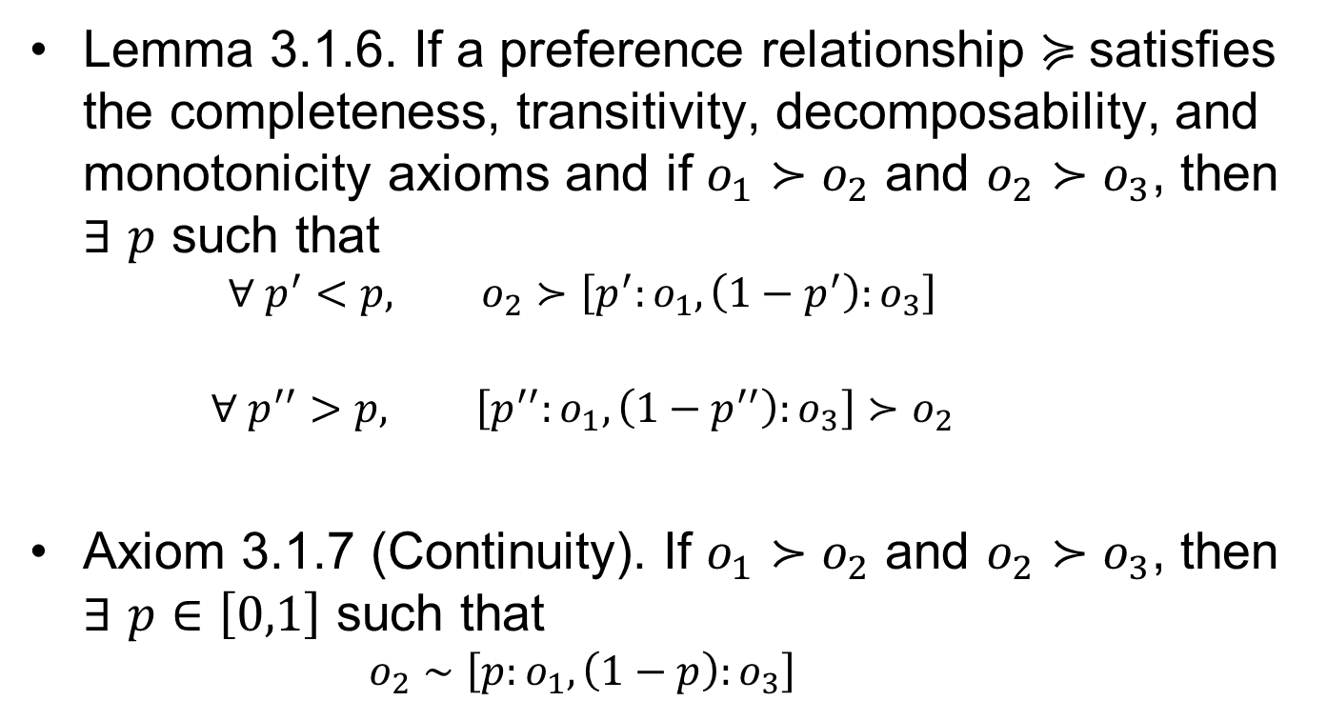
Axioms of Utility Theory (2 of 2)
Lemma 3.1.6. If a preference relationship $≽$satisfies the completeness, transitivity, decomposability, and monotonicity axioms and if $o_{1}≻o_{2}$ and $o_{2}≻o_{3}$, then $∃$ $p$ such that
$$∀ p^{′}<p, o_{2}≻\left[p^{′}:o_{1},\left(1−p^{′}\right):o_{3}\right]$$
$$∀ p^{′′}>p, \left[p^{′′}:o_{1},\left(1−p^{′′}\right):o_{3}\right]≻o_{2}$$
Axiom 3.1.7 (Continuity). If $o_{1}≻o_{2}$ and $o_{2}≻o_{3}$, then $∃$ $p∈\left[0,1\right]$ such that
$$o_{2}∼\left[p:o_{1},\left(1−p\right):o_{3}\right]$$

Slide 12
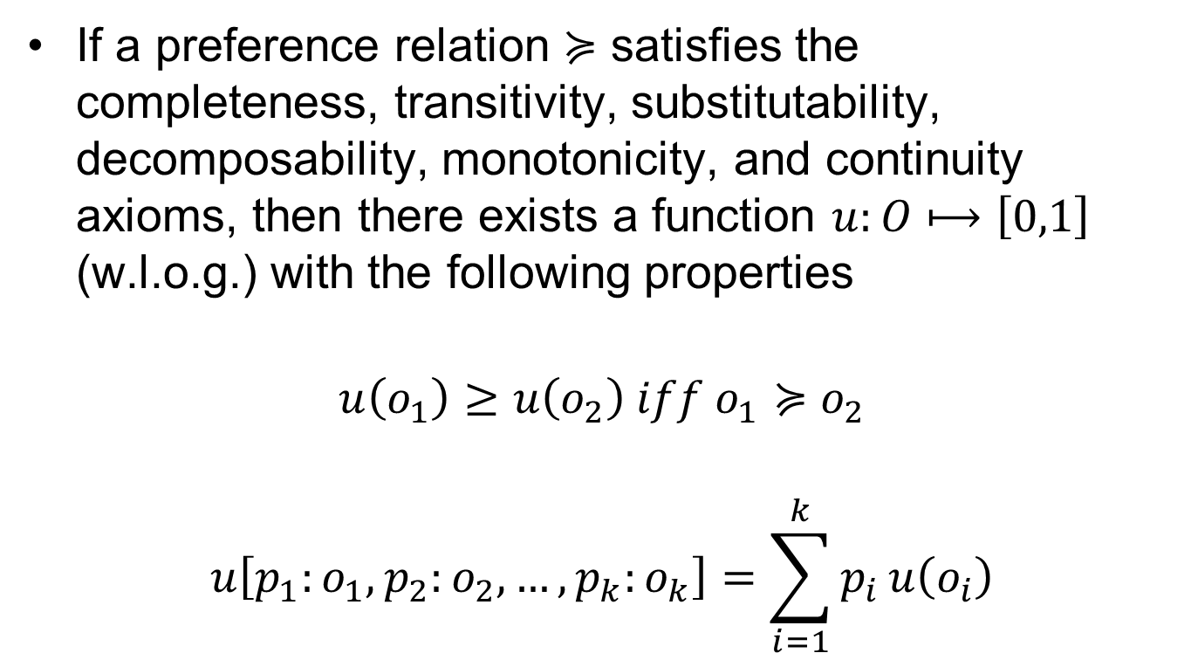
Von Neumann & Morgenstern Theorem on Lottery Values
If a preference relation $≽$ satisfies the completeness, transitivity, substitutability, decomposability, monotonicity, and continuity axioms, then there exists a function $u:O⟼\left[0,1\right]$ (w.l.o.g.) with the following properties
$$u\left(o_{1}\right)≥u\left(o_{2}\right) iff o_{1}≽o_{2}$$
$$u\left[p_{1}:o_{1},p_{2}:o_{2},…,p_{k}:o_{k}\right]=\sum_{i=1}^{k}{p_{i}}u\left(o_{i}\right)$$

Slide 13
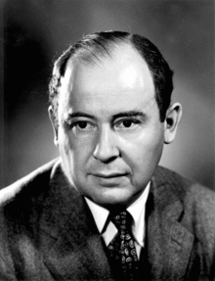
John von Neumann 1903-1957
Hungarian-American mathematician.
Worked in the fields of mathematics, physics, economics, computing, and statistics.
Founded the field of game theory with Morgenstern as a mathematical discipline.
Worked on the Manhattan Project, modeling explosive lenses for the implosion-type weapon.
Worked with Edward Teller and others on key physics for thermonuclear reactions (i.e., H-bomb).

Slide 14
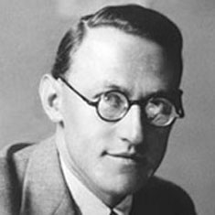
Oskar Morgenstern 1902-1977
German-born economist.
Grew up in Vienna, where he earned his PhD in 1925 and taught economics from 1928-1938.
Joined Princeton in 1938 when visiting the US. Why?
Worked with von Neumann to publish “Theory of Games and Economic Behavior” in 1944.
Became a US citizen in 1944.

Slide 15
On the Quantification of Utility
“…not everything that can be counted counts, and not everything that counts can be counted”
– William Bruce Cameron
Quantification of outcomes in terms of utility is not measured directly. It’s typically measured by:
Detailed decision-maker interviews
Observed choice (a.k.a., revealed preferences)
Inferred preferences

Slide 16


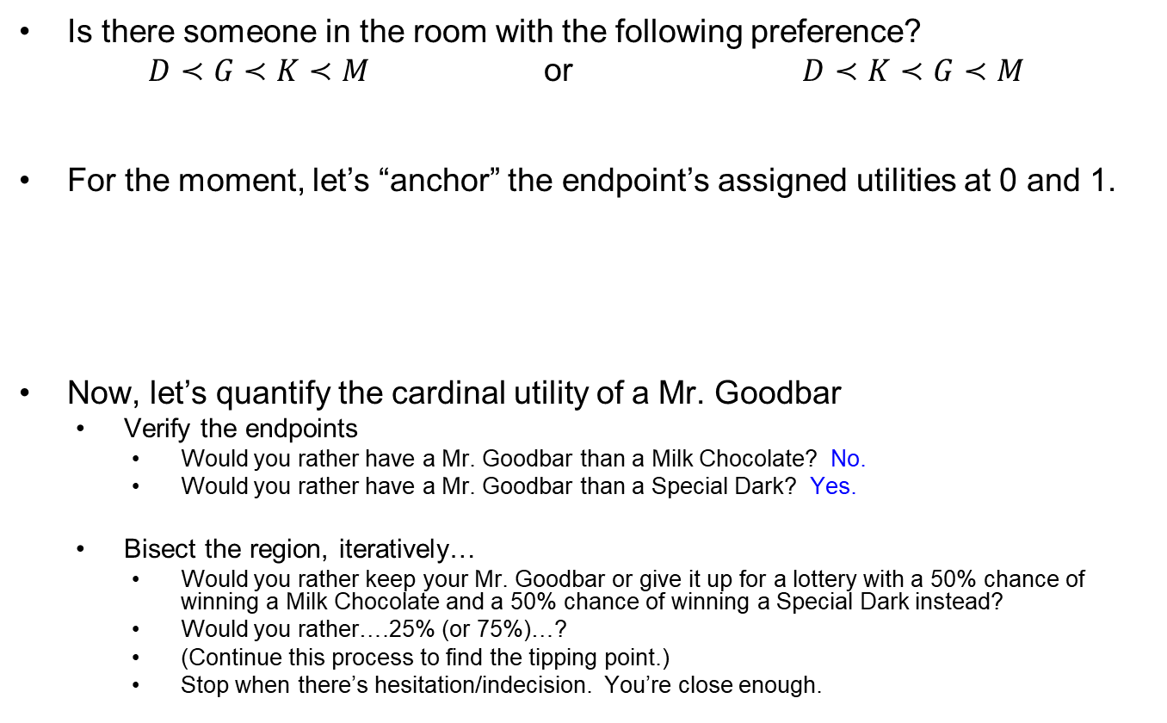
Quantifying Utility via Decision-maker interview
Is there someone in the room with the following preference?
$D≺G≺K≺M$ or $D≺K≺G≺M$
For the moment, let’s “anchor” the endpoint’s assigned utilities at 0 and 1.
Now, let’s quantify the cardinal utility of a Mr. Goodbar
Verify the endpoints
Would you rather have a Mr. Goodbar than a Milk Chocolate? No.
Would you rather have a Mr. Goodbar than a Special Dark? Yes.
Bisect the region, iteratively…
Would you rather keep your Mr. Goodbar or give it up for a lottery with a 50% chance of winning a Milk Chocolate and a 50% chance of winning a Special Dark instead?
Would you rather….25% (or 75%)…?
(Continue this process to find the tipping point.)
Stop when there’s hesitation/indecision. You’re close enough.
0
0.25?
0.5?
0.75?
1
Utility

Slide 17
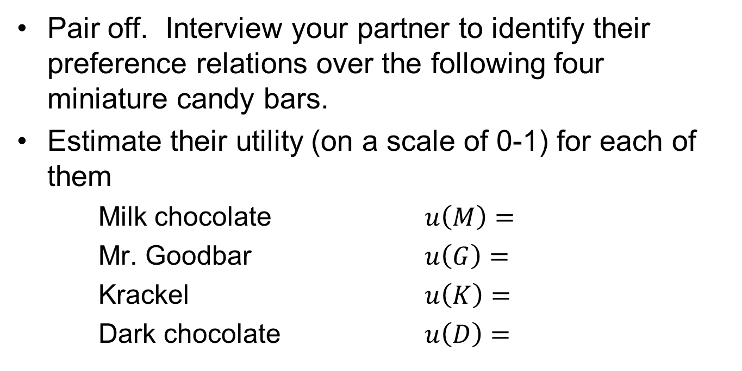
Quantifying Utility (Revisited)
Pair off. Interview your partner to identify their preference relations over the following four miniature candy bars.
Estimate their utility (on a scale of 0-1) for each of them
Milk chocolate $u\left(M\right)=$
Mr. Goodbar $u\left(G\right)=$
Krackel $u\left(K\right)=$
Dark chocolate $u\left(D\right)=$

Slide 18
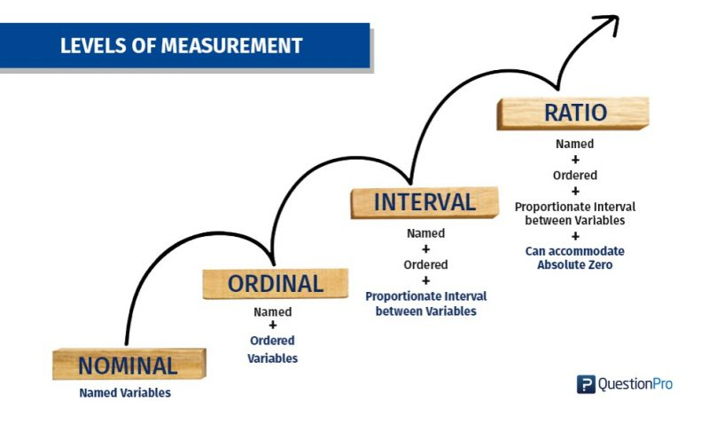
Measurement Theory (Stevens, 1975)
Measure | Property | Mathematical Operators | Advanced Operations | Central Tendency
Nominal | Classification, membership | =, ≠ | Grouping | Mode
Ordinal | Comparison, level | > , < | Sorting | Median
Interval | Difference, Affinity | + , – | Yardstick | Mean, Deviation
Ratio | Magnitude, amount | x, / | Ratio | Geometric mean, coefficient of variation
What type of measurement is required for VnM EUT Theory?

Slide 19
Discussion Questions
Did (how did) the relative utilities of the outcomes change via a lottery-based evaluation?
What are the practical implications of your answer?
How else might you quantify utilities for outcomes?
What are some shortcomings to our method for quantifying utilities? What are some alternatives?

Slide 20
Questions & Discussion

